Slide 1
Build your toolbox: In depth data manipulation with MarcEdit to prepare your data for the ANBD
Terry Reese
reeset@gmail.com

Slide 2
Data Files
PowerPoint: http://marcedit.reeset.net/workshops/aussie/session2/aussie_2.pptx
Data: http://marcedit.reeset.net/workshops/aussie/session2/data.zip

Slide 3
Session Themes
Working with MarcEdit’s Regular Expression Language
Regular Expression Samples
Isolating and Manipulating Data
How do I find data missing a particular field or subfield?
Removing invalid control characters?
Looking at MarcEdit’s Global Editing Functions
Edit Shortcuts
Working with XML Data
How do they work?
How can I change them?

Slide 4
MarcEdit Regular Expression Support
Functions that presently support regular expressions
Delete Field
Edit Field
Copy Field
Swap Field
Build New Field
Validation
Extract/Delete Selected Records

Slide 5
Microsoft’s Regular Expression language
Concepts:
Character escapes
Anchors
Character classes
Grouping
Qualifiers
Substitutions
Let’s open Regular Expression Language - Quick Reference.html or https://msdn.microsoft.com/en-us/library/az24scfc(v=vs.110).aspx

Slide 6
How we use Regular Expressions in MarcEdit
Your most important parts of the regular expression language are:
Character escapes: \d\r\n\$\x##
Character Classes [] & [^]
Grouping Elements ()
Anchors: ^$
Quantifiers: *?+{#}
Substitutions: $#

Slide 7
Examples
Looking at regex_example.mrk using the replace function:
Add a period to the 500 if it is missing
Update the 300 to reflect electronic information
Split the 856 into two fields, breaking on the $u.

Slide 8
Examples 1
Add a period to the 500 if it is missing
Find What: (=500 ..)(.*[^.]$)
Replace With: $1$2.
Explanation:
(=500 ..)
Searches for the 500 field. We leave two blanks because there are always 2 blank characters as part of the mnemonic format. The two periods which stand for any character. If we want to search for exact indicators, you’d place those values rather than the periods.
(.*[^.]$)
Take any characters, and match on a field where the last character in the field isn’t a period.

Slide 9
Examples 2
Add online resource information to the 300 field
Example:
Change: 300 \\$a 32 p.
To: 300 \\$a1 online resource (32 p.)
Explanation:
(=500 ..)
Searches for the 500 field. We leave two blanks because there are always 2 blank characters as part of the mnemonic format. The two periods which stand for any character. If we want to search for exact indicators, you’d place those values rather than the periods.
(?<one>\$a)([^$]*)
Capture the $a and then all data in the subfield until you get to the next subfield (if there is one)

Slide 10
Example 3
Split the 856 into two fields, breaking on the $u.
Find What: (=856.{4})(\$u.*[^$])(\$u.*)
(=856.{4})
Matches the 856 field
(\$u.*[^$])
Match $u, but stop at the end of the subfield
(\$u.*)
Match reminder of field
Replace With: $1$2\n=856 41$3

Slide 11
lcase/ucase
MarcEdit’s regular expression engine includes to extension functions for dealing with case switching of characters.
lcase & ucase
Usage: (=450.{4})(\$a.)(.*)
$1$2lcase($3)
Example: Find the 500 with all upper case characters and convert the case of all values but the first letter in the sentence to lower case.

Slide 12
Example (lcase)
Find the 500 with all upper case characters and convert the case of all values but the first letter in the sentence to lower case.
Find What: (=500.{4})(\$a.)([A-Z .]*)
Replace With: $1$2lcase($3)

Slide 13
Multi-Field Replacements
By default, MarcEdit handles one field at a time when doing regular expressions.
However, when you need to do evaluations against multiple fields, you can by adding /m to the end of your replacement in the Replace Function in the MarcEditor
This is a special function added to the MarcEdit regular expression engine
Notes:
Lcase and ucase

Slide 14
Example
Using regex_example.mrk
Changing video disc to blue-ray in the 300 if the 538 is marked as blue-ray

Slide 15
Multi-Line Example

Slide 16
Isolating and Manipulating Data
Question:
Missing Fields 260 or 264 Publication Details - V1.mrk is designed to show how to remove records without either one of the Libraries Australia required data element fields 260 or 264. This is a tricky one because some records have only a field 260, only a 264, both, or none. Only records without both need to be removed.
Two Answers:
Extract Select Records with the field search. Check retain options and invert selections at the end
Use the RDA Helper, target only the 260, and convert all 260s. Then you just have to find those missing a 264 (much easier)

Slide 17
Isolating and Manipulating Data
Question:
Move Field 001 Control Number to Field 035 System Control Number - V1.mrk is designed to show how to transfer the member’s local system number from field 001 (reserved for Libraries Australia numbers) to field 035. A second field 035 can also contain an OCLC record number.
Answer:
Lots of ways to do this – easiest – use the copy field data tool if you don’t need to make any edits
Build New Field Tool if you need to make edits to the data before creating the new field and then Delete Field to remove the 001 if necessary.

Slide 18
Isolating and Manipulating Data
Question:
Invalid Control Code - Escape Code 07 Bell - V1.mrc and the associated log file Invalid Control Code - Escape Code 07 Bell - V1 - Warning Log File.txt is designed to show how to identify device control codes in MARC records. The text file should be viewed with a fixed-width font for best results. Hex code 07 Bell is in field 520. The log file does not show a character, because there is none.
Question:
This is slightly harder because MarcEdit doesn’t know that these are not characters that you want. It also assumes you are working in MARC8, because these would be almost impossible to find in the Unicode data.
Use the Find all to determine if any exist
Use Extract Selected; using a regular expression and searching all fields

Slide 20
Isolating and Manipulating Data
Question:
How do I deal with line breaks in fields copied from other data (example, data in the 520)
When the Data is in MARC
When the Data is copied into MarcEdit’s mnemonic format

Slide 21
MARC Conversions
Notes:
This is really the heart of MarcEdit
All utilities and functions interact with the MARCEngine in some fashion.

Slide 22
MarcEdit: crosswalking design
MarcEdit model:
So long as a schema has been mapped to MARCXML, any metadata combination could be utilized. This means that no more than two transformations will ever take place. Example: MODS → MARCXML → EAD

Slide 23
MarcEdit: crosswalking design
MarcEdit Crosswalk model
Pro
Crosswalks need not be directly related to each other
Requires crosswalker to know specific knowledge of only one schema
Con
each known crosswalk must be mapped to MARCXML.

Slide 24
MarcEdit Crosswalking model
MARC21XML
EAD
FGDC
MODS
MARC
Dublin Core

Slide 25
MarcEdit: Crosswalks for everyone

Slide 26
MarcEdit: Crosswalks for everyone
What’s MarcEdit doing?
Facilitates the crosswalk by:
Performing character translations (MARC8-UTF8)
Facilitates interaction between binary and XML formats.

Slide 27
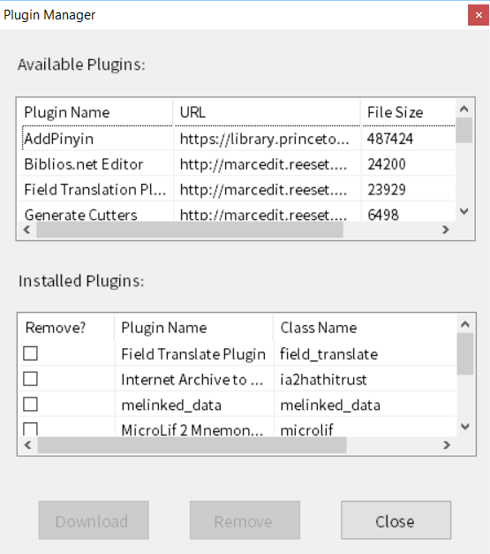
MarcEdit Plugins

Slide 28
Working With UNIMARC Data
Building off the XML Platform, Unimarc processing was added leveraging an XSLT and some coding to enable processing of data of any file size

Slide 29
MarcEdit and SQL Data
MarcEdit includes and SQL Explorer
Can be integrated into the MarcEditor
Support SQLite and MYSQL
Available in All version of MarcEdit
Designed for large file sets (I’ve worked with up to 1 TB)

Slide 30
Questions

