Slide 1
Real-world data editing with MarcEdit
Terry Reese; reeset@gmail.com

Slide 2
Ask Questions
In this session, I’m hoping to:
Demonstrate specific aspects of the Application utilizing real-data
Provide some targeted demonstration and application of new editing functionality
Demonstrate editing techniques within the MarcEditor
Provide an opportunity to ask new questions.

Slide 3
Ask Questions
I’ve created this presentation based on questions I’ve received from the list – but please, ask questions as we go through this.
DATA: http://marcedit.reeset.net/anonymous/aar/wed/data.zip
PowerPoint: http://marcedit.reeset.net/anonymous/aar/wed/Wednesday.pptx

Slide 4
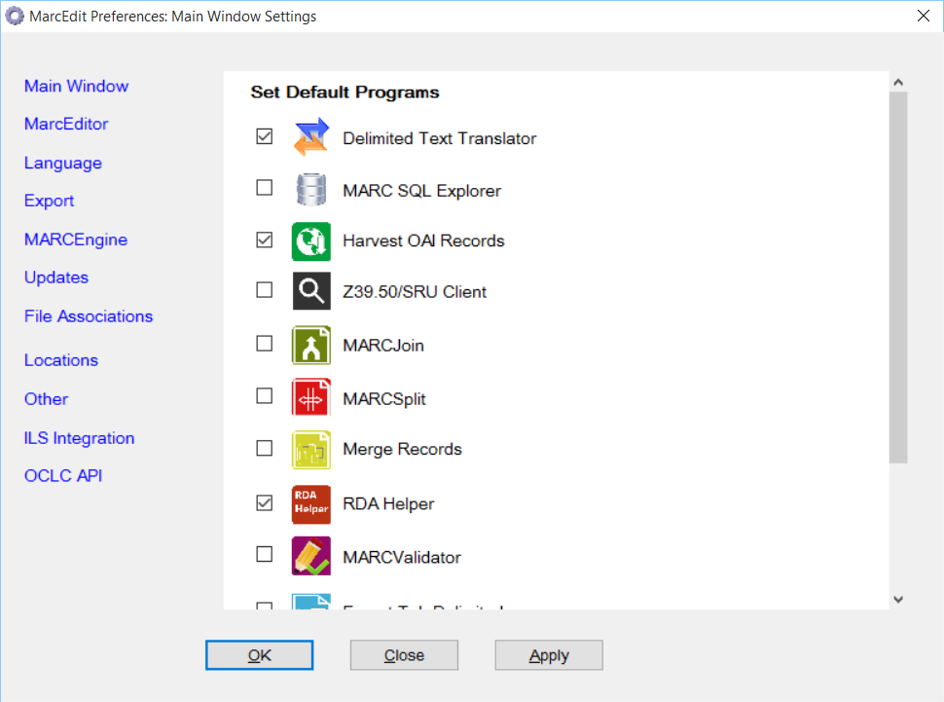
Setting up MarcEdit
On first run, MarcEdit will ask you to confirm some settings.

Slide 5
MarcEdit Program Settings
MarcEdit allows you to customize the most widely used programs onto the front page.

Slide 6
MarcEdit Language Preferences
MarcEdit allows you to set your preferred font for use with the User Interface.
MarcEdit allows you to set your preferred font size for use within the program.

Slide 7
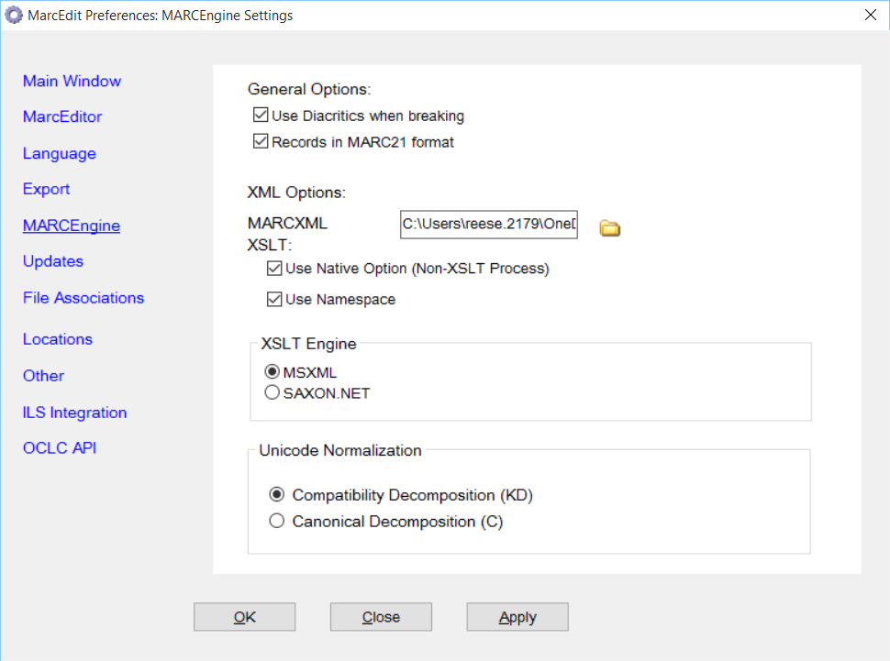
MARCEngine Settings
Of Note:
Use Diacritics turns mnemonics on and off
MARCXML XSLT determines how data moves between MarcEdit’s mnemonic format and MARCXML
XSLT Engine
Saxon.net supports XSLT 2.0
MSXML supports XSLT 1.0, but is orders of magnitude faster
Unicode Normalization
New feature designed to allow international users to break away from MARC21’s preferred KD normalization

Slide 8
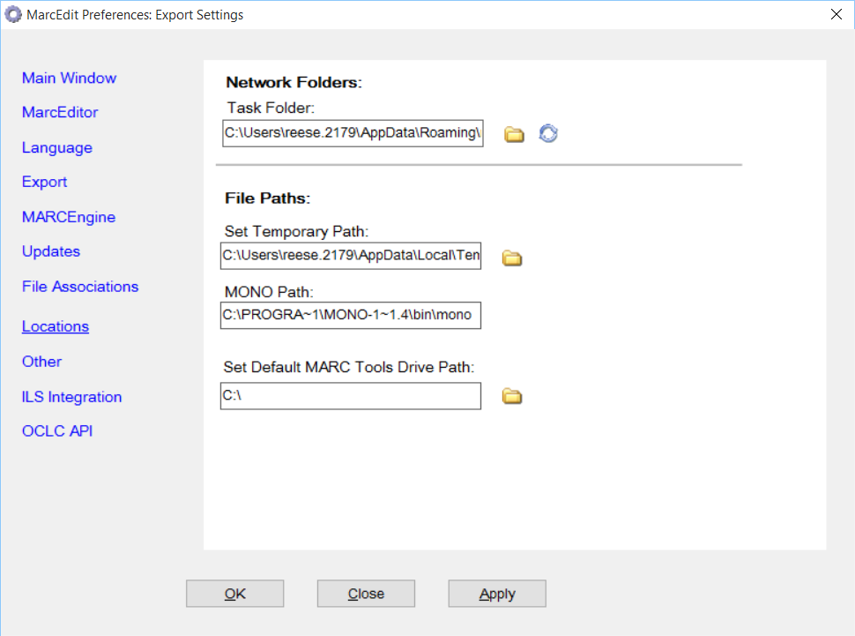
MarcEdit – Miscellaneous properties
Properties that affect sorting, notification, file storage.

Slide 9
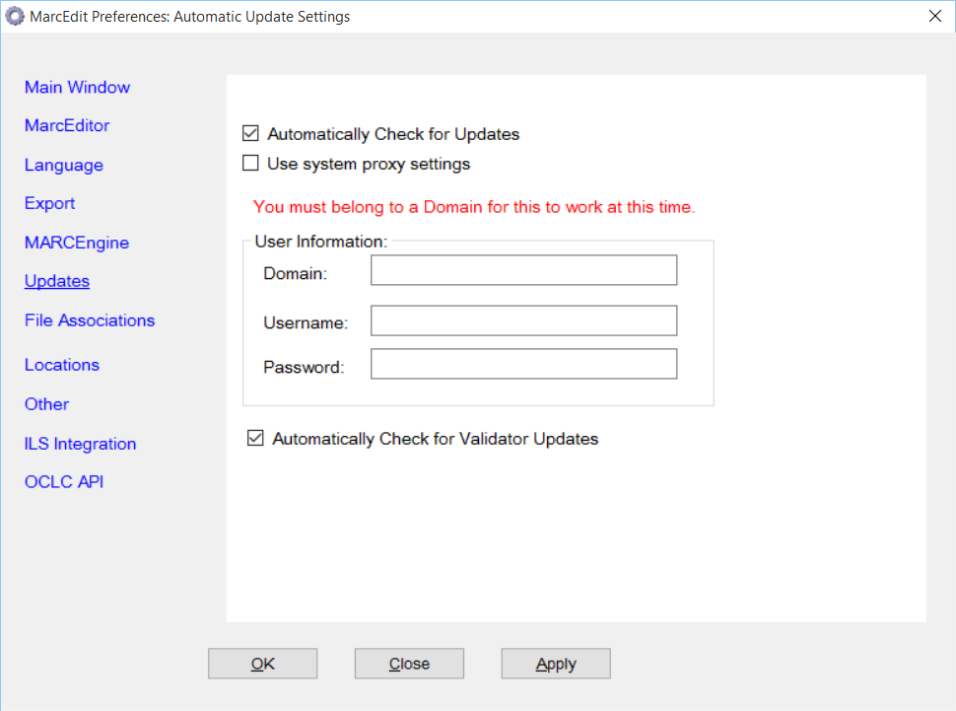
MarcEdit Automated Updates
MarcEdit includes options for Automatic updates
Update Notifications
Auto updates as administrative users
Only works on Professional/Enterprise/Ultimate versions of Windows (requires domain information)

Slide 10
MarcEdit Regular Expression Support
When processing regular expressions with MarcEdit, MarcEdit makes entire fields or subfields available for processing
i.e., when processing a delete field function – all data from =[field number] are part of the field that can be queried.
MarcEdit’s regular expression by default deals with one field at a time (i.e., regular expressions do not allow you to find data across fields by default)
MarcEdit’s Regular Expression Support Pre-5.x was a custom regular expression engine.
MarcEdit’s Regular Expression Support 5.x+ is defined by Microsoft .NET’s Regular Expression object
This object uses a syntax that looks Perl-like, but has some differences.

Slide 11
MarcEdit Regular Expression Support
When working with regular expressions with the Replace Function, MarcEdit will remember the last 10 replacements. This should help with trial and error.
When dealing with Regular Expressions or any global replacements, MarcEdit has a Special Undo function that will undo your last global update.

Slide 12
Microsoft’s Regular Expression language
Concepts:
Character escapes
Anchors
Character classes
Grouping
Qualifiers
Substitutions
Let’s open Regular Expression Language - Quick Reference.html or https://msdn.microsoft.com/en-us/library/az24scfc(v=vs.110).aspx

Slide 13
How we use Regular Expressions in MarcEdit
Your most important parts of the regular expression language are:
Character escapes: \d\r\n\$\x##
Character Classes [] & [^]
Grouping Elements ()
Anchors: ^$
Quantifiers: *?+{#}
Substitutions: $#

Slide 14
Examples
Looking at example.txt using the replace function:
Add a period to the 500 if it is missing
Add a $h of cartographic resources between the $a and $c .
Split the 856 into two fields, breaking on the $u.

Slide 15
Examples 1
Add a period to the 500 if it is missing
Find What: (=500 ..)(.*[^.]$)
Replace With: $1$2.
Explanation:
(=500 ..)
Searches for the 500 field. We leave two blanks because there are always 2 blank characters as part of the mnemonic format. The two periods which stand for any character. If we want to search for exact indicators, you’d place those values rather than the periods.
(.*[^.]$)
Take any characters, and match on a field where the last character in the field isn’t a period.

Slide 16
Example 2
Add a $h of cartographic resources between the $a and $c .
Find What: (=245.{4})(\$a.*)(/.*)
(=245.{4})
Match the 245 field with any value in the next 4 characters being valid.
(\$a.*)
Select everything within the subfield a
(/\$c.*)
Select the / value and the subfield c (and other data)
Replace With: $1$2$$h[cartographic resource] $3

Slide 17
Example 3
Split the 856 into two fields, breaking on the $u.
Find What: (=856.{4})(\$u.*[^$])(\$u.*)
(=856.{4})
Matches the 856 field
(\$u.*[^$])
Match $u, but stop at the end of the subfield
(\$u.*)
Match reminder of field
Replace With: $1$2\n=856 41$3

Slide 18
Learning More about regular expressions
We are going to look at examples that are going to include regular expressions. Nearly all of MarcEdit’s edit functions support regular expressions – giving users an incredible amount of control over their own data.
Learning Regular Expressions for use in MarcEdit:
.NET Regular Expression Quick Reference: https://msdn.microsoft.com/en-us/library/az24scfc(v=vs.110).aspx
Regular Expression Tutorial (general RegEx, not .NET specific): http://www.regular-expressions.info/tutorial.html
30 Minute RegEx Tutorial (.NET Specific): http://www.codeproject.com/Articles/9099/The-Minute-Regex-Tutorial

Slide 19
Learning Regular Expressions
For those starting out – the best way to learn regular expression processing is to do it, and to ask questions while trying.
The MarcEdit Listserv is home to a number of talented regular expression wizards. As you work through expressions that may help you manipulate your data – I would encourage you to utilize the ListServ.
ListServ is found at: https://listserv.gmu.edu/cgi-bin/wa?SUBED1=marcedit-l&A=1

Slide 20
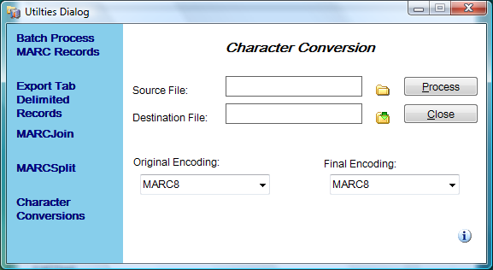
MARC Character Conversions
Supports moving between any known Windows Characterset and MARC8.
Can be run from the Breaker/Maker – or as its own standalone utility

Slide 21
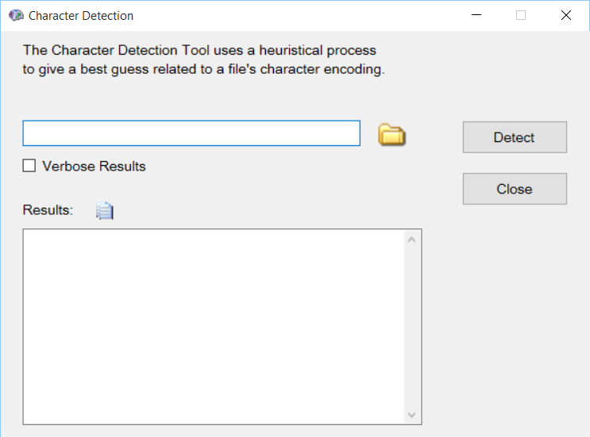
AutoDetect Characterset
Uses a heuristical process to determine characterset
Not exact – but helps to provide an estimated guess in relation to characterset

Slide 22
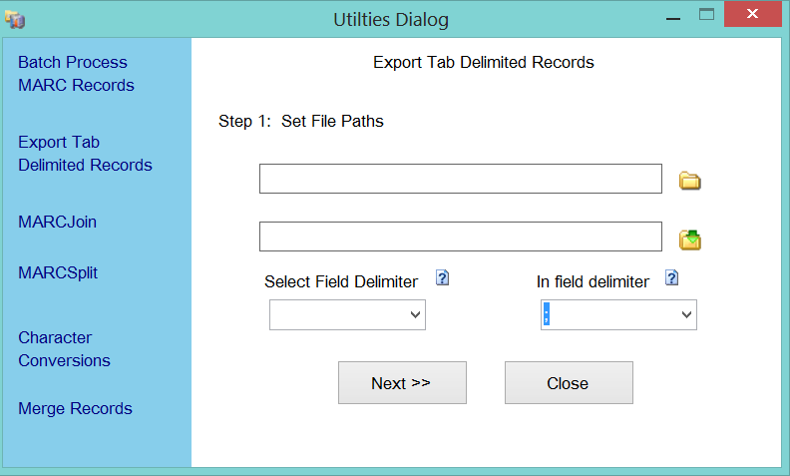
Export Tab Delimited Records
MarcEdit does not support direct translation of MARC to Excel/delimited formats.
However, you can define data for export
By Field
By Field/Subfield
By control value/position

Slide 23
Delimited text translator
Delimited Text Translator
Translates Tab, comma, pipe, Excel (Office 2000-2007), Access (Office 2000-2007) files into MARC
Can save translation maps
Can create constant data

Slide 24
Delimited text translator Options
Wizard-like interface
Supports Unicode data (in excel or delimited file)
Joining (relating) fields
Editing global 008/LDR

Slide 25
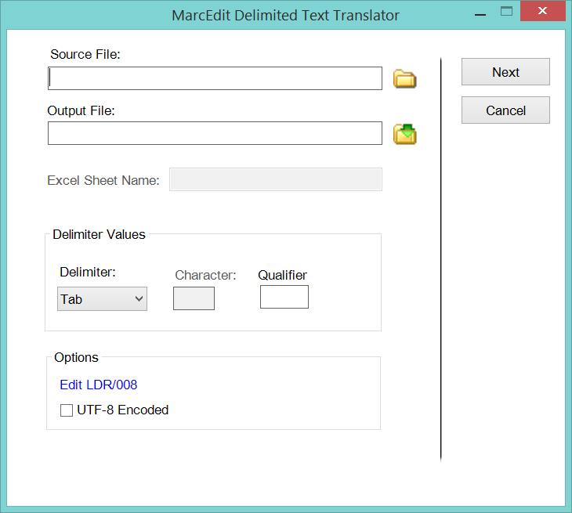
Delimited Text Translator: Mapping format
Map to: Field + subfield
Indicators: Indicator values
Term Punct.: Trailing punctuation
Arguments – Joining defined items (select and right click on items)
Ability to save templates

Slide 26
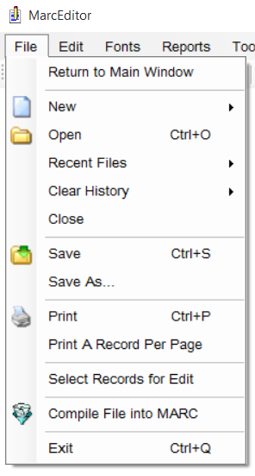
Question #1
What is the difference between “save” or “Save as” and “Compile file into MARC”?
Save: If a file is already open, it simply saves changes into the opened file. If the file opened is a temporary file (i.e., previewing the file), Save will initiate the Save As function and prompt the user to select a file to save the data. If the user opens a mrc file directly from the MarcEditor, the Save button saves the changes back to the mrc file (in MARC).
Save As: Always prompts the user to select a file to save the MarcEditor content. This will always save data in mnemonic format.
Compile file into MARC: prompts the user to select a save file for the compiled MARC record. The compile tool does not save the mnemonic data. If the user may want to reopen the mnemonic file for editing, they would want to Save the file.

Slide 27
Question #2
Is there a way to find records that specifically have a 650 /4 field?
There are a variety of ways to accomplish this task, and the best method will depend on what the user is looking to do with the data. Available options can be broken down into 2 categories:
Lists
Data Subsets

Slide 28
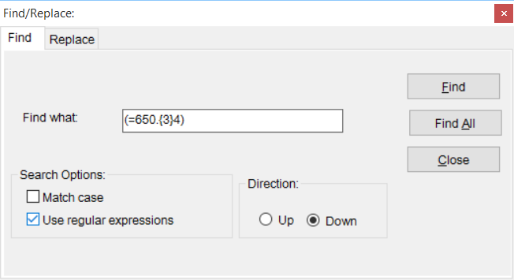
Question #2
Lists:
From within the MarcEditor, a user can retrieve a records list of all the items matching a specific criteria. In this case, a user looking for a field with specific indicators could utilize the Find All Function with the following regular expression:
Expression: (=650.{3}[^7])
* Find all 650 fields, where the second indicator isn’t a 7.

Slide 29
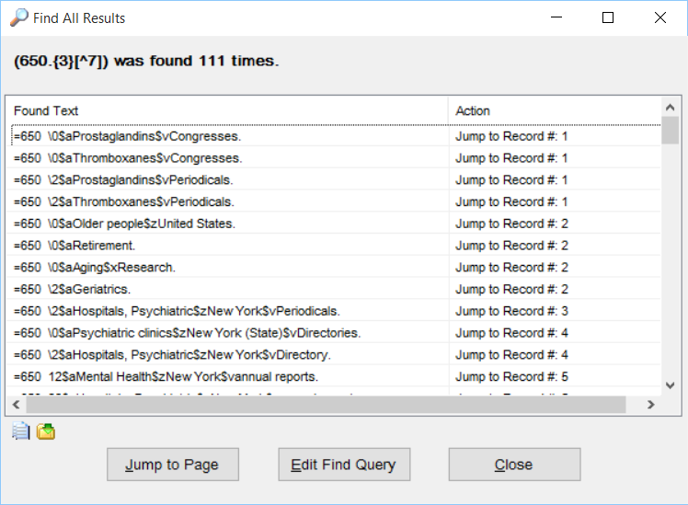
Question #2
Lists:
Expressions using Find All generate a Jump List that allow the user to see their query in context:

Slide 30
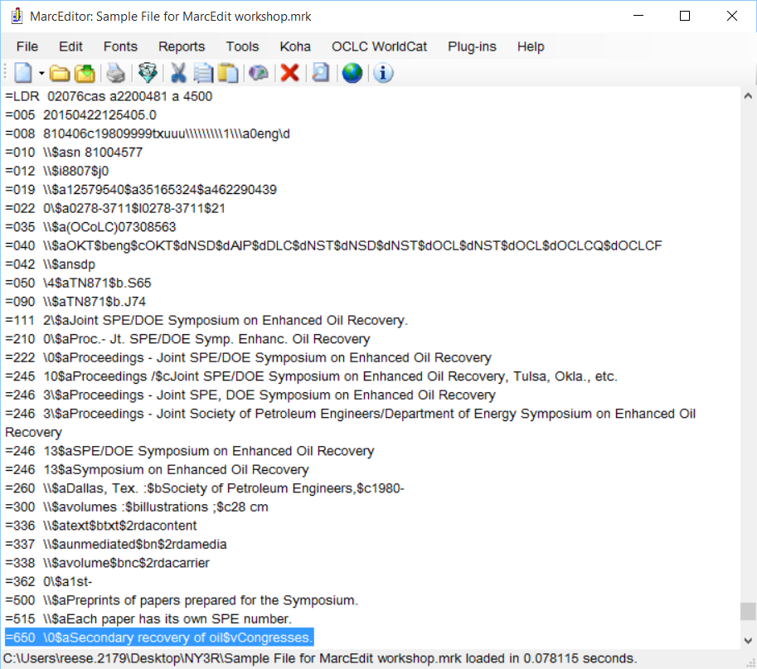
Question #2
Lists:
And selecting a record to jump to – takes the user to the record, with their field highlighted for evaluation

Slide 31
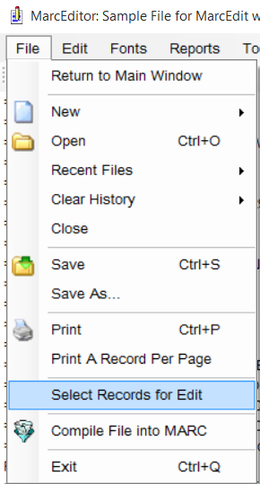
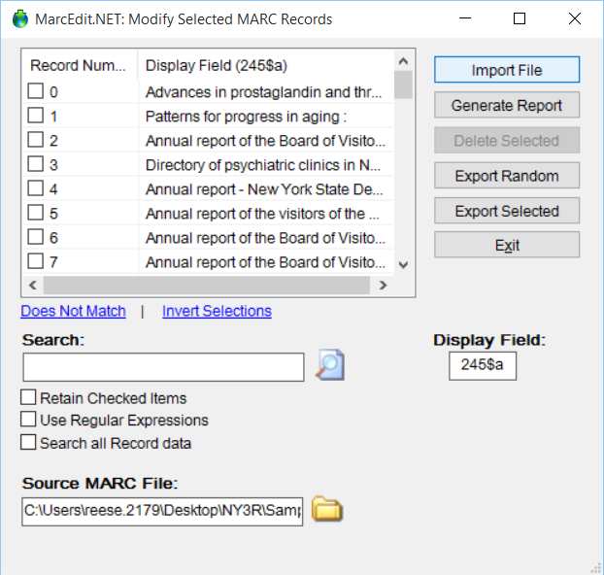
Question #2
Data Subsets:
MarcEdit includes a tool to Extract Selected Records…a tool that can be run from within the MarcEditor or outside the MarcEditor. Depending on where the tool is run, it will do different things.
Within the MarcEditor:

Slide 32
Question #2
Data Subsets:
When run from within the MarcEditor, users can select a subset of data, pull that subset into the MarcEditor, edit just that data, and then save the data back into the original source file by clicking the “Save” button.
When run from outside the MarcEditor, users can select a subset of data and export that subset into a new file. During export, users can request that the data being exported be removed from the source data file.

Slide 33
Question #2
Data Subsets:
Extract/Delete Selected Records Search Options:
General search – searches just the item from the display field
Search all record data – searches all record data using either a regular expression or in-string match
Invert selections – invert selected data.
Find records that do not match a specific field
Special Search options:
F#:000$a [search data]
R#:1-12 [select a range]

Slide 34
Question #3
Adding a proxy to my records
Add an 856 url to all records that uses the OCLC number from the 035 field, the title from 245 $a, and the ISSN, if present. This will populate an ILLiad form with the publication title, ISSN, call number (same for all records), and OCLC number. Although I haven’t worked it in yet, the link in our catalog will also include instructions to “click for document delivery form” or something like that.

Slide 35
Question #3
There are a number of ways to add proxy information to a record. The most common are using the Replace Function and using the Edit Subfield Tool. There is also a third option, the Build Proxy tool which works better for more complicated proxy building tasks.

Slide 36
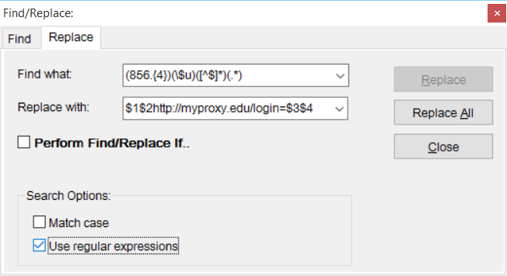
Question #3
Using the Replace Function:
This method works well for users utilizing a proxy method like OCLC’s EZProxy.

Slide 37
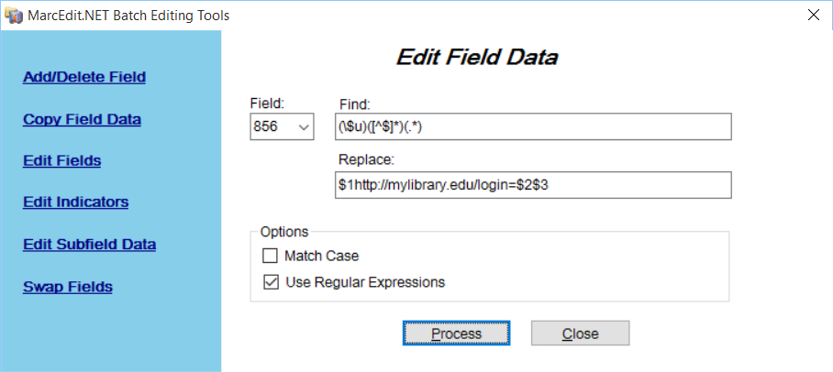
Question #3
Using the Edit Field Function
This method works well for users utilizing a proxy method like OCLC’s EZProxy.

Slide 38
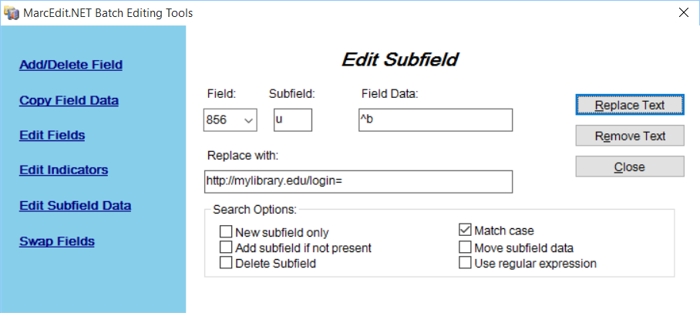
Question #3
Using the Edit Subfield Function
This method works well for users utilizing a proxy method like OCLC’s EZProxy.

Slide 39
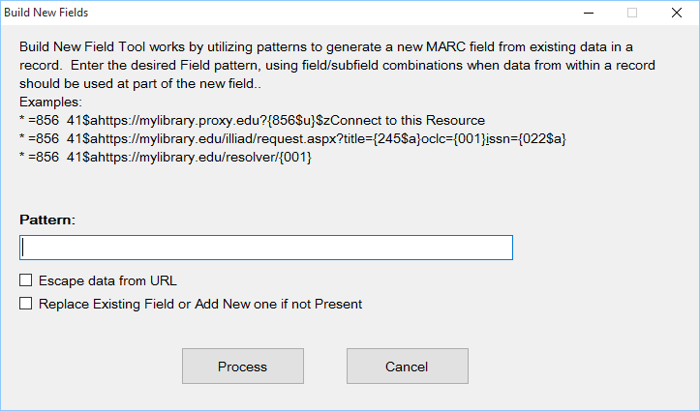
Question #3
Build New Field Tool
This method works well when needing to build complex proxy statements

Slide 40
Question #4
How does the RDA Helper Work, and can you track changes?
Currently, the RDA Tool doesn’t track this information. You see a status that tells you how many records have been processed, but the tool doesn’t give you specific data regarding what operations the resource was able to complete.
However…

Slide 41
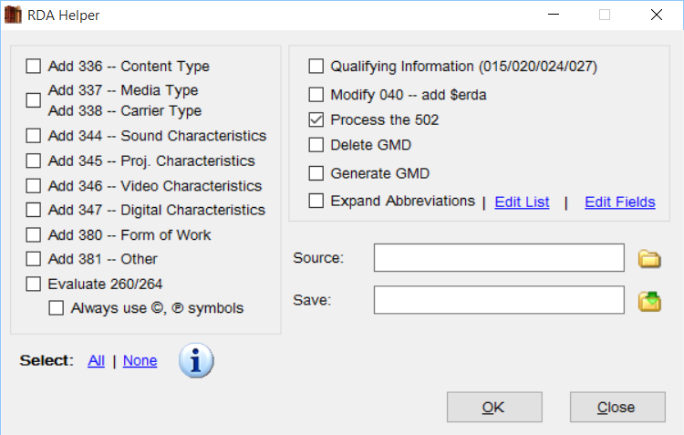
Question 4: RDA Helper

Slide 42
Question 4: RDA Helper
Special Instructions:
380 – Because this isn’t a controlled field, MarcEdit makes use a genre list at the Library of Congress. This means that these values can be more general than if done by a cataloger.
260/264 – Handles many different forms of the field. When the tool is always set to generate a symbol, the tool will utilize MARC8 or UTF8 encoding based on the data.
Qualifying information – moved qualifiers into a $q. Example: 020 $a02312123 (electronic) to 020 $a02312123$qelectronic
Process the 502 – converts a dissertation note into a delimited format. Example: 502 $aThesis (M.A.)--University College, London, 1969. to: 502 502 $gThesis$bM.A.$cUniversity College, London$d1969.
Generate GMD (works on AACR2 encoded data or RDA Encoded data)
Abbreviation expansion can be customized (using regular expressions) and fields where abbreviations are run can be customized.

Slide 43
Question #4
Using the Field Count function before and after the RDA Helper operation would allow a user to profile the changes that have occurred in a record.

Slide 44
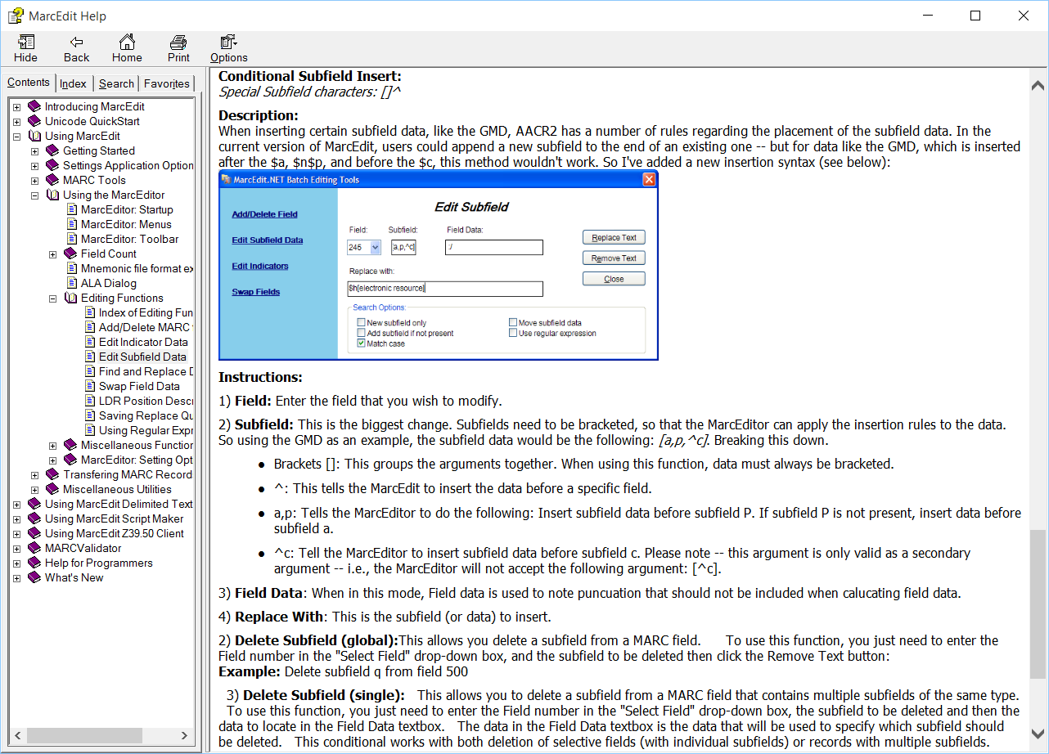
Question #5
Is there a way to batch-insert a subfield between two other existing subfields – for instance, a way to add a $h after the $a, but before the $b, in the 245 field?
Yes, using the Edit Subfield Function, and the special insert format. From the Help file:

Slide 45
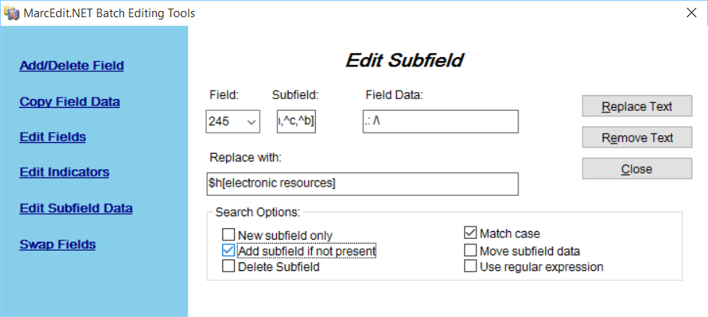
Question #5
GMD Example:

Slide 46
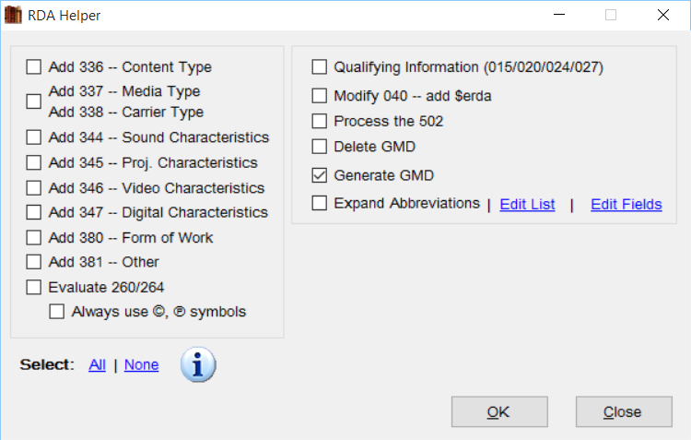
Question #5
Better GMD Example:

Slide 47
Question #6
Is there a way to batch-insert the same 3-letter code in front of the information in a given field – for instance, is there a way to insert the letters “SPA” in front of different call numbers in the 099 fields of a hundred records at once?
Using the Edit Subfield Function. The tool provides special options that allow a user to easily prepend, append or change a subfield code.
^b – prepend ^e – append ^c – change subfield code

Slide 48
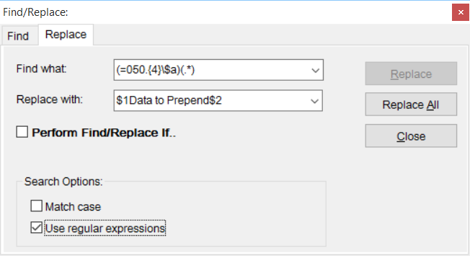
Question #6
A second option is to use the Replace Function with a regular expression.
Example – prepend a code to the date in the call number found in the 050

Slide 49
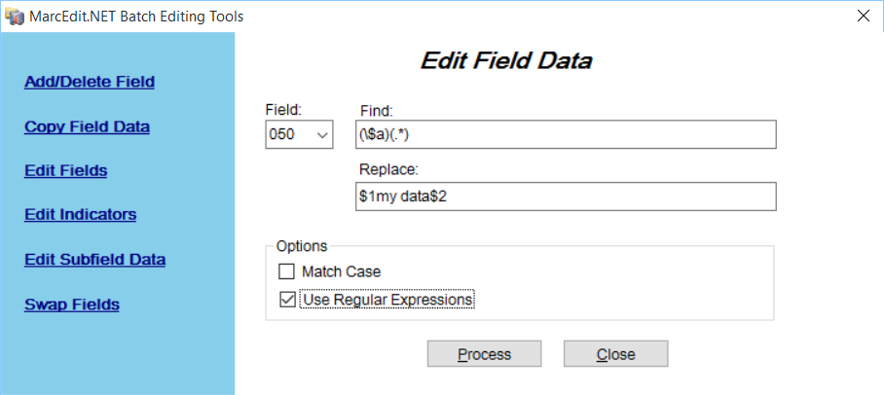
Question #6
A third option is to use the Edit Field Function with a regular expression.
Example – prepend a code to the date in the call number found in the 050

Slide 50
Question #7
In a file containing many records, we can ask MarcEdit to “jump to” record 173, or record 68 – is there a way to know, when we are in the middle of a large file of records, what number record we are looking at? If not, is there a way we can assign running numbers to a file of records, so that they are visually labeled “1,2,3,”etc.?
The MarcEdit mnemonic format has the ability to add comments that are ignored on compilation. Comments within the format begin with #. i.e.
=LDR 02219cas a2200553 4500 #This is a comment and will be ignored =005 20150405102612.0 =008 760405d19761980nyuuu\m\\\\\\\0\\\d0eng\c

Slide 51
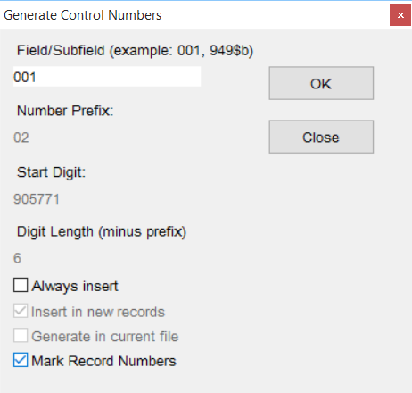
Question #7
MarcEdit has a tool though that can add record numbers to a file. It is found in the Control Number generator (not a good place for it now that I think about it)

Slide 52
Question #8
Automating Workflows
MarcEdit includes a task manager that allows user the ability to “record” macros that can then perform multiple steps all at once. What’s more, because tasks are procedural – each task that follows can perform actions based on the result of the task action above it.

Slide 53
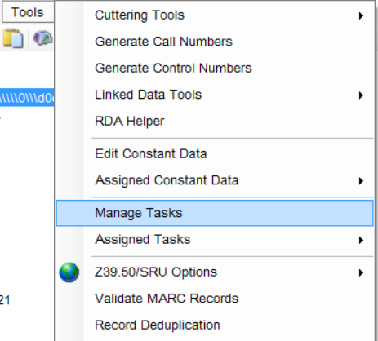
Question #8
Task Automation Example

Slide 54
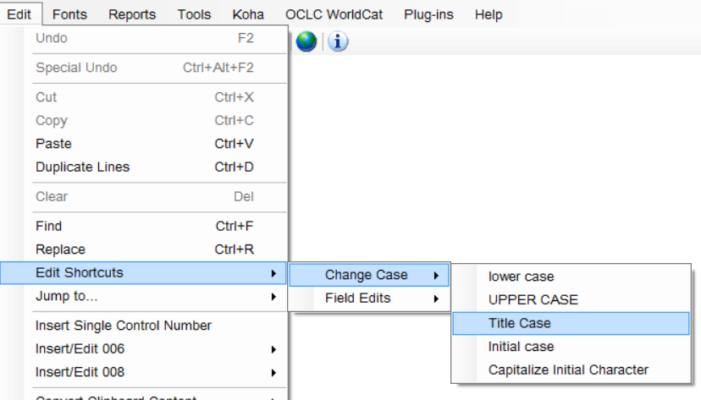
Question #9
Vendor records send records where some fields are all in upper case. Can MarcEdit fix this?
Yes, MarcEdit has a set of Edit Shortcuts that support a variety of edit actions. One of these is case processing.

Slide 55
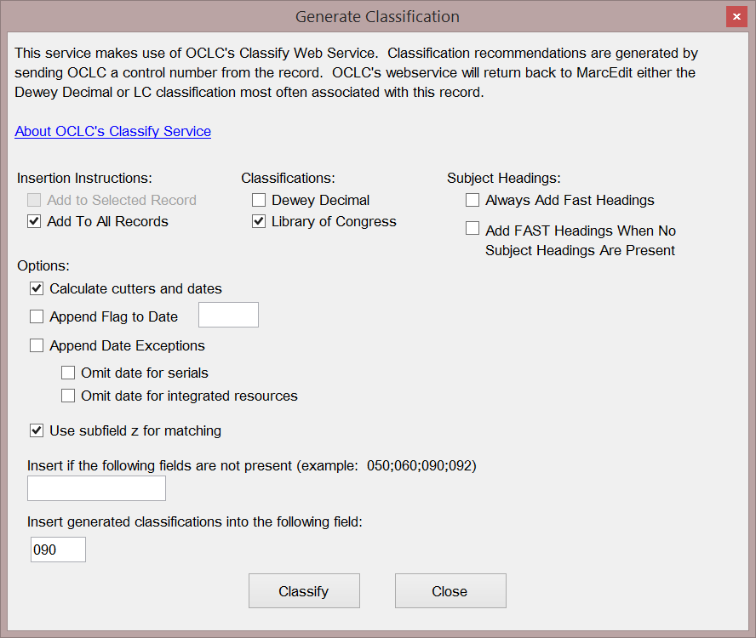
Question 10
I have a set of ebook records, and I’d like to insert a call number
MarcEdit can leverage OCLC WorldCat to generate call numbers automatically for files
Fields used:
001
010$a$z
020$a$z
022$a$z
024$a$z
1xx$a
776$w$z

Slide 56
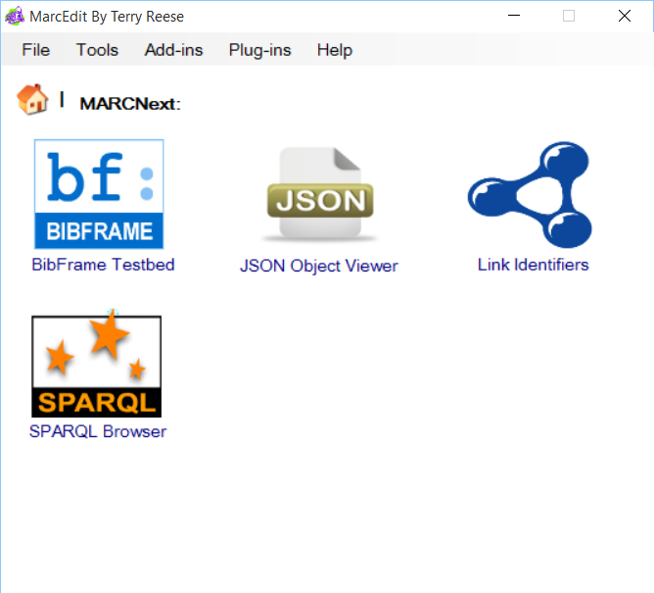
MARCNext
Represents a testbed of tools to help catalogers think about what comes next

Slide 57
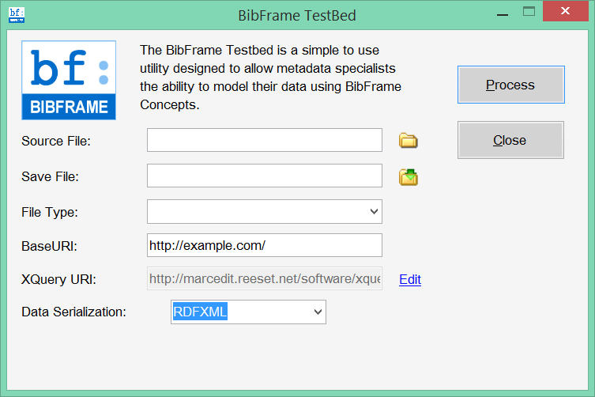
BibFrame Testbed

Slide 58
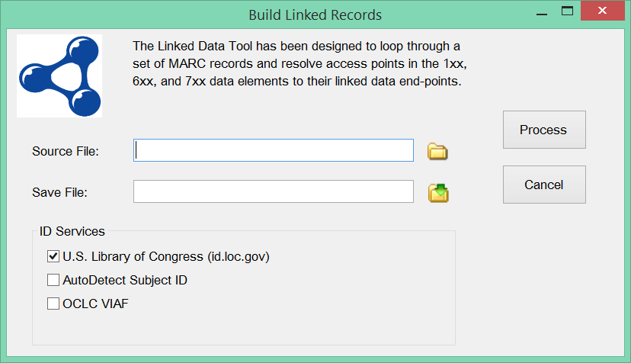
Linking Identifiers

Slide 59
Validating Headings
New to MarcEdit is a new reporting feature that can be used to validate headings against the Library of Congress Authority file.
The tool generates a report, provides an option to isolate records that need work, and the ability to generate an excel report.
Functionality that will soon be coming will be the ability to automatically correct variants when located.

Slide 60
Validating Headings

Slide 61
Conditional Replacements
MarcEdit’s Replace Function has always been one of the most powerful functions in the application, but doing replacements that required the evaluation of multiple data points has always been incredibly difficult.
Introduced a month or two ago – the ability to do a conditional query to match specific records, prior to performing the actual search and replacement.

Slide 62
Conditional Replacements

Slide 63
MARCValidator Changes
MarcValidator has two modes:
When working with MARC (.mrc) files
Validate Records – Uses the Rules file to validate content against MARC21 rules.
Identify Invalid Records – identifies records that are unable to be processed by the strict processing algorithm
Remove Invalid Records – removes records that are unable to be processed by the strict processing algorithm
When working with Mnemonic (.mrk) files
Validate Records – Uses the Rules file to validate content against MARC21 rules.
Identify Invalid Records – identify records that are unable to be compiled back into MARC. This process identifies common structural problems, as well as undefined errors that block compilation.
Remove Invalid Records – removes records that are unable to be compiled back into MARC.

Slide 64
Merge Record Changes

Slide 65
Koha Integration
MarcEdit provides direct integration with Koha via:
Koha API for create, update, and delete operations
This allows users to edit:
Bibliographic Records
Holdings Records
Z39.50
For Search and Discovery

Slide 66
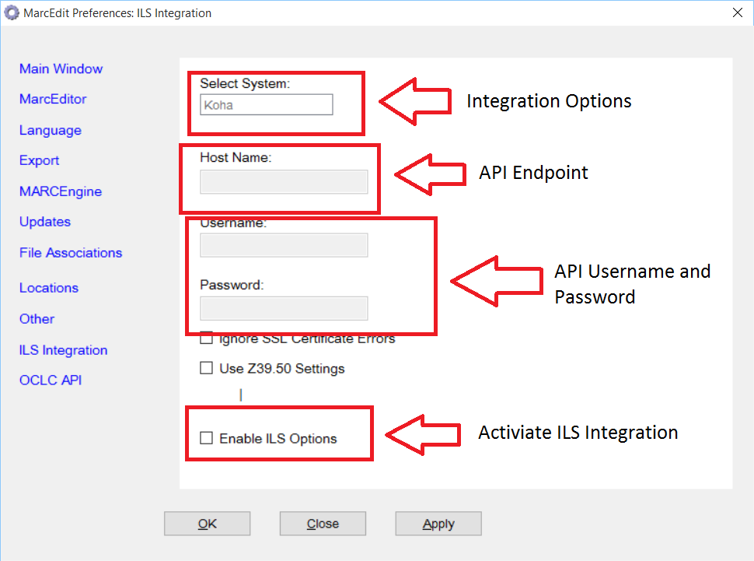
Koha Integration
Integration is turned on via the preferences

Slide 67
Automating through scripts
Using the Script Wizard
Using the Command-line tool

Slide 68
MarcEdit and OpenRefine

Slide 69
More Questions?

